Slide 1
Overview of File Organizations and Indexing
SUN YAT-SEN UNIVERSITY

Slide 2
Alternative File Organizations(文件组织)
Many alternatives exist, each good for some situations, and not so good in others:
  Heap files(堆文件): Suitable when typical access is a file scan retrieving all records.
  Sorted Files(排序文件): Best for retrieval in search key order, or only a “range” of records is needed.
  Clustered Files (with Indexes) (聚簇文件): Coming soon…

Slide 3
Cost Model(代价模型) for Analysis
B: The number of data blocks
R: Number of records per block
D: (Average) time to read or write a disk block
Average-case analyses for uniform random workloads
We will ignore:
  Sequential vs. Random I/O
  Pre-fetching
  Any in-memory costs

Slide 4
More Assumptions
Single record insert and delete.
Equality selection(等值选择)
  exactly one match
For Heap Files:
  Insert always appends to end of file.
For Sorted Files:
  Files compacted after deletions.
  Selections on search key.

Slide 5
Cost of Operations
  B: The number of data pages
  R: Number of records per page
  D: (Average) time to read or write disk page
 | Heap File | Sorted File | Clustered File
Scan all records
Equality Search
Range Search
Insert
Delete

Slide 6
Cost of Operations
  B: The number of data pages
  R: Number of records per page
  D: (Average) time to read or write disk page
 | Heap File | Sorted File | Clustered File
Scan all records | BD | BD
Equality Search
Range Search
Insert
Delete

Slide 7
Cost of Operations
  B: The number of data pages
  R: Number of records per page
  D: (Average) time to read or write disk page
 | Heap File | Sorted File | Clustered File
Scan all records | BD | BD
Equality Search | 0.5 BD | (log₂ B) * D
Range Search
Insert
Delete

Slide 8
Cost of Operations
  B: The number of data pages
  R: Number of records per page
  D: (Average) time to read or write disk page
 | Heap File | Sorted File | Clustered File
Scan all records | BD | BD
Equality Search | 0.5 BD | (log₂ B) * D
Range(范围) Search | BD | [(log₂ B) + #match pg]*D
Insert
Delete

Slide 9
Cost of Operations
  B: The number of data pages
  R: Number of records per page
  D: (Average) time to read or write disk page
 | Heap File | Sorted File | Clustered File
Scan all records | BD | BD
Equality Search | 0.5 BD | (log₂ B) * D
Range Search | BD | [(log₂ B) + #match pg]*D
Insert | 2D | ((log₂B)+B)D
Delete

Slide 10
Cost of Operations
  B: The number of data pages
  R: Number of records per page
  D: (Average) time to read or write disk page
 | Heap File | Sorted File | Clustered File
Scan all records | BD | BD
Equality Search | 0.5 BD | (log₂ B) * D
Range Search | BD | [(log₂ B) + #match pg]*D
Insert | 2D | ((log₂B)+B)D
Delete | 0.5BD + D | ((log₂B)+B)D (because R,W 0.5)

Slide 11
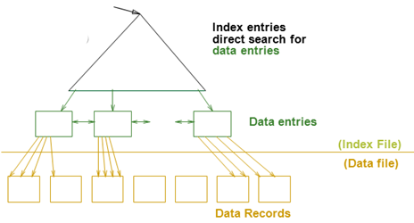
Indexes – 索引
用途: Allow record retrieval by value in one or more fields
  Find all students in the “CS” department
  Find all students with a gpa > 3
Index : disk-based data structure for fast lookup by value
  Search key(搜索键): any subset of columns in the relation.
  Search key need not be a key of the relation
    Can have multiple items matching a lookup
  索引是为关系文件建立的索引文件
  索引文件由两部份组成
    数据项部分
      Data Entry(数据项) data record（数据记录）
    引导部份
      树索引技术
      Hash索引

Slide 12
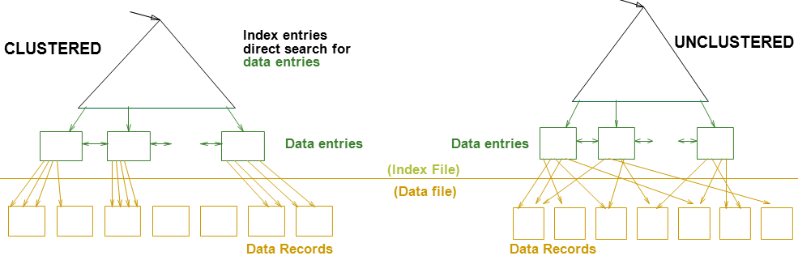
Indexes – 索引(Contd.)
  索引是文件
Index contains a collection of data entries (数据项)
  Items associated with each search key value k -- k*
Three alternatives for Data Entry k*:
  Actual data record (with key value k) -- 数据记录
  <k, rid>, rid is record id of matching data record
  <k, rid-list>, rid-list is list of rids of matching data records
Data Entry(数据项) data record（数据记录）

Slide 13
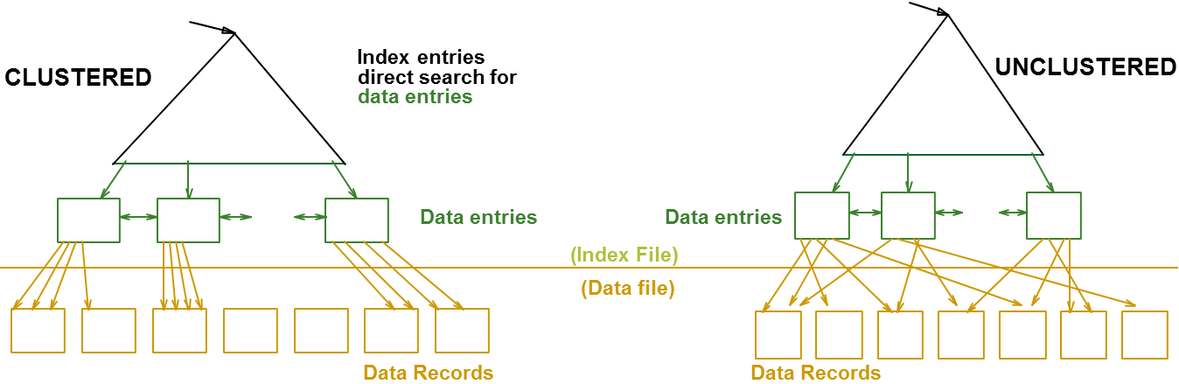
Index Classification –索引分类
Clustered vs. Unclustered:
    Cost of retrieving data records through index varies greatly based on whether index is clustered or not!
Clustered index – 聚簇索引:
  order of data records the same as, or `close to’, order of index data entries
  Alternative 1 implies clustered, but not vice-versa.

Slide 14
Unclustered vs. Clustered Indexes
Clustered Pros –优点
  Efficient for range searches
  Possible locality benefits
    Disk scheduling, prefetching, etc.
Clustered Cons-缺点
  More expensive to maintain
    on the fly or “sloppily” via reorganizations
    Heap file usually only packed to 2/3 to accommodate inserts

Slide 15
Cost of Operations
  B: The number of data pages
  R: Number of records per page
  D: (Average) time to read or write disk page
 | Heap File | Sorted File | Clustered File
Scan all records | BD | BD | 1.5 BD
Equality Search | 0.5 BD | (log₂ B) * D | (log_{F} 1.5B) * D
Range Search | BD | [(log₂ B) + #match pg]*D | [(log_{F} 1.5B) + #match pg]*D
Insert | 2D | ((log₂B)+B)D | ((log_{F} 1.5B)+1) * D
Delete | 0.5BD + D | ((log₂B)+B)D (because R,W 0.5) | ((log_{F} 1.5B)+1) * D
Alternative 1

